Slide 1
Z3 Internals
Nikolaj Bjørner, Microsoft Research, RiSE
Clemens Eisenhofer, TU Wien
POPL tutorials, January 14, 2023

Slide 2
Overview
x
s

Slide 3
Material
z3 source on GitHub https://github.com/z3prover/z3
Online guide https://microsoft.github.io/z3guide
Tutorial document https://z3prover.github.io/papers/z3internals.html

Slide 4

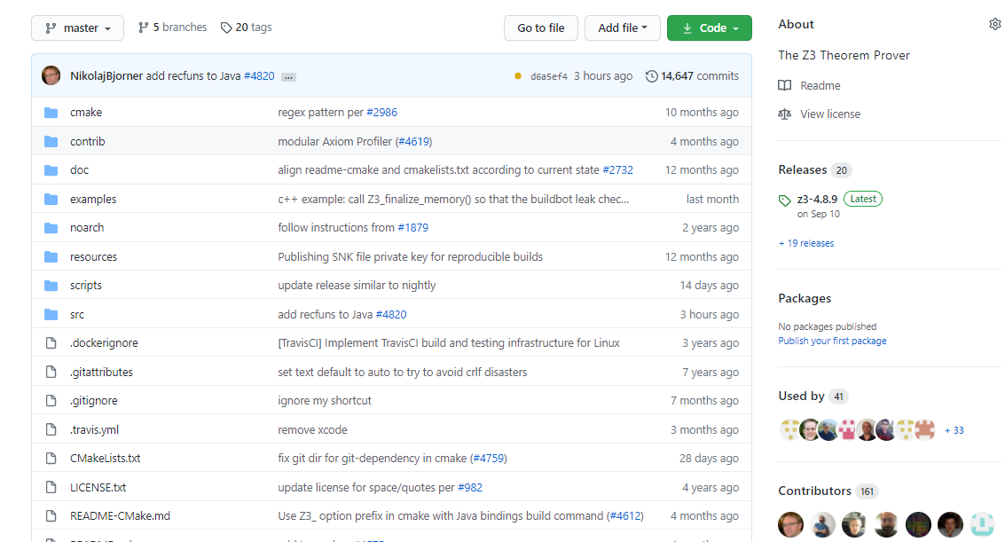
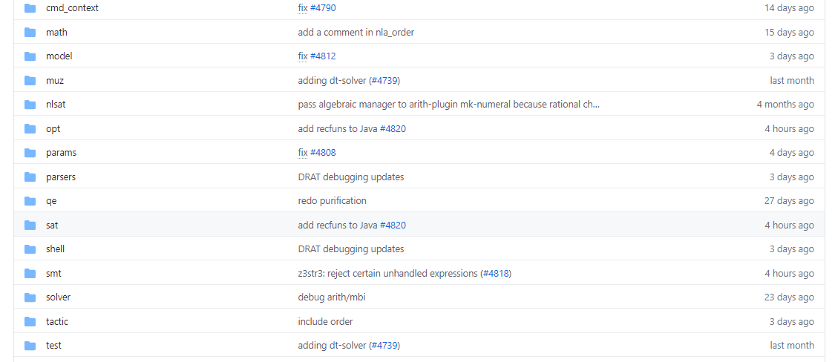
on GitHub
Scope of this tutorial

Slide 5
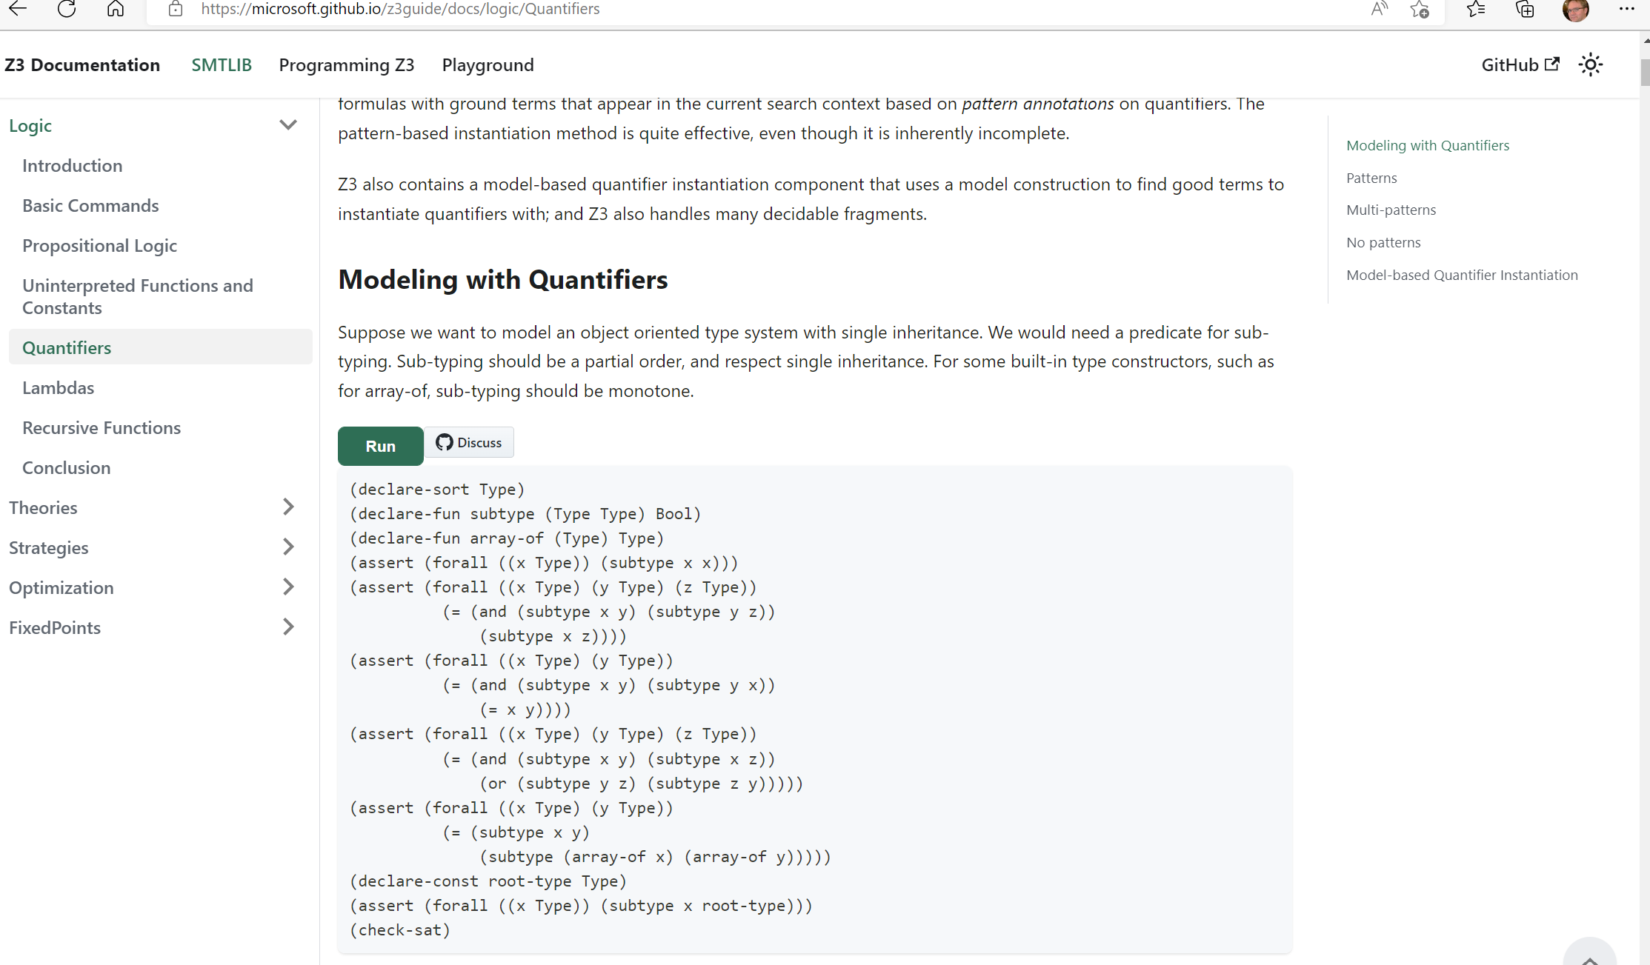
Online guide

Slide 6
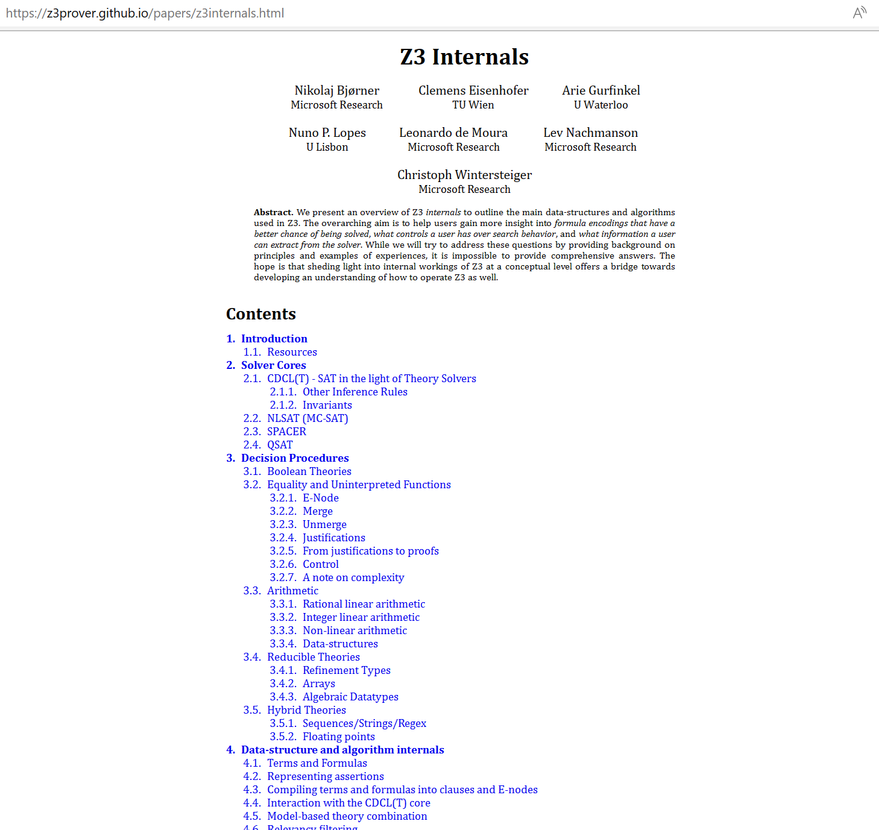
Tutorial document

Slide 7
What to expect when expecting a z3 internals tutorial?

Slide 8



What (some) users want to learn
How can I tune formulas to be solved by Z3?
What features of Z3 should I use for solving formulas?
Can I control the output of Z3
models (to be diverse, random)?
How can I have Z3 provide feedback on solving?
How can I determine which strategies apply to my formulas?

Slide 9
What a developer likes to talk about
Solvers
Algorithms
Data-structures
Logic features
Proof systems
Heuristics
Anatomy of Congruence Closure
How do solvers interact (with the core)?
How do solvers implement search?

Slide 10
Tutorial format
Understand Core Concepts
Understand where to dig further
Use cases shaped by anecdotes

Slide 11
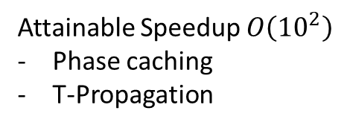
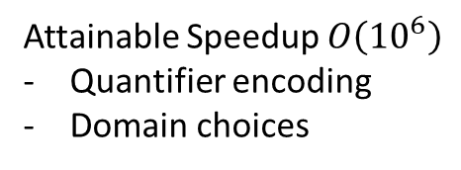
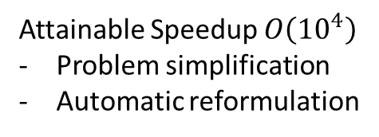
Encodings, Pre-processing, Search
Encoding
Attainable Speedup $O\left({10}^{6}\right)$
Quantifier encoding
Domain choices
New
Theory solver
Pre-processing (Tactics)
Attainable Speedup $O\left({10}^{4}\right)$
Problem simplification
Automatic reformulation
Advances in Search
Attainable Speedup $O\left({10}^{2}\right)$
Phase caching
T-Propagation
Thanks to D.O.F. Pons

Slide 12
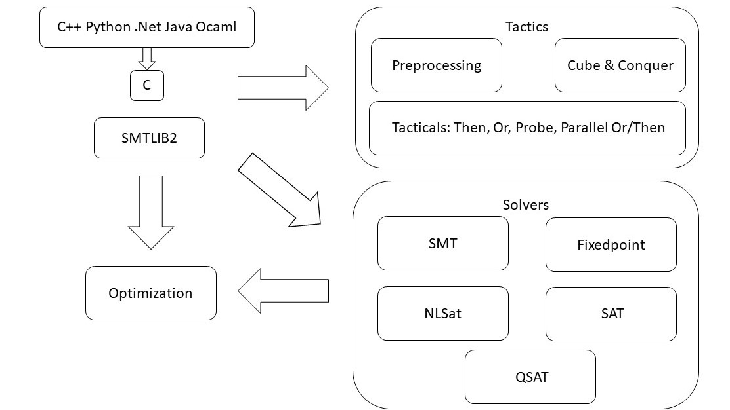
overview

Slide 13
Solver Engines
CDCL(T) SPACER NLSAT QSAT

Slide 14
overview

Slide 15

CDCL(T)
SAT
Theory
Solvers
SMT
Equality + UF
Arithmetic
Bit-vectors
…
Case Analysis

Slide 16

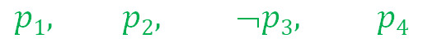

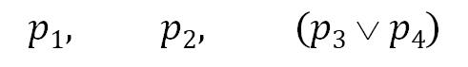

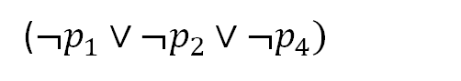
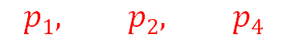
CDCL(T)
x ≥ 0, y = x + 1, (y > 2 ∨ y < 1)
$$α$$
$$p1, p2, (p3  p4)$$
Strengthen
($¬p_{1}∨¬p_{2}∨¬p_{4})$
SAT
Block
$$p1, p2, ➢p3, p4$$
$$p1, p2, p4$$
$$γ$$
$$α$$
Theory Conflict
x ≥ 0, y = x + 1, y ≤ 1, y < 1
x ≥ 0, y = x + 1, y < 1

Slide 17
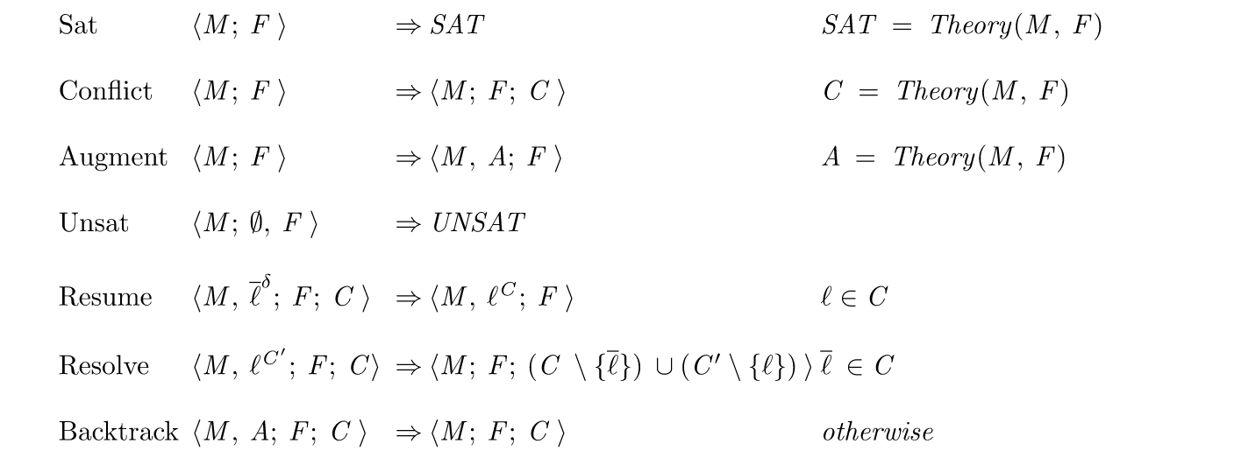
CDCL(T) as inference rules

Slide 18
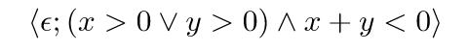
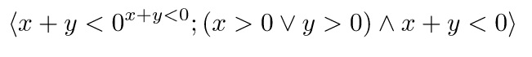
CDCL(T) as inference rules

Slide 19
CDCL(T) as inference rules

Slide 20
CDCL(T) as inference rules

Slide 21
CDCL(T) as inference rules

Slide 22
CDCL(T) as inference rules

Slide 23
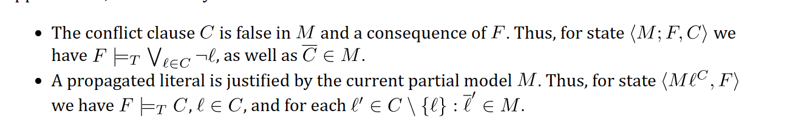
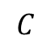
CDCL(T) - Invariants
M
F
$$C$$

Slide 24
CDCL(T) – Dual Model/Proof search
Backjump
Models
literal assignments
Proofs
Conflict Clauses
Conflict Resolution
Propagate

Slide 25
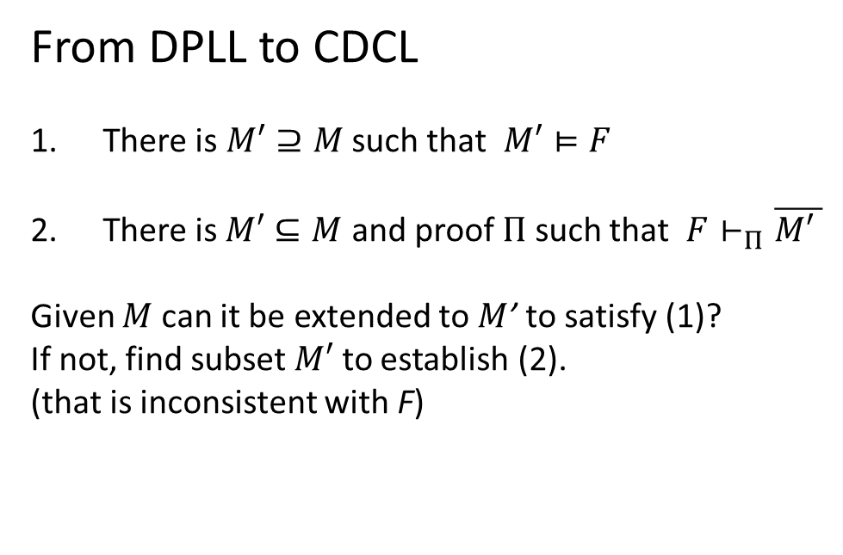
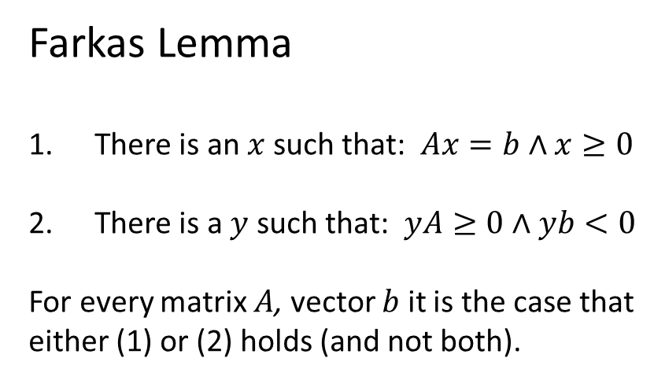
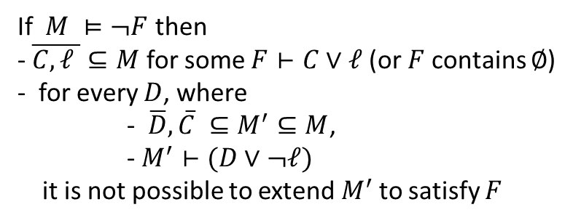
Dichotomy – Proofs and Models
Farkas Lemma
There is an $x$ such that: $Ax=b∧x≥0$
There is a $y$ such that: $yA≥0∧yb<0$
For every matrix $A$, vector $b$ it is the case that
either (1) or (2) holds (and not both).
From DPLL to CDCL
There is $M′⊇M$ such that $M′⊨F$
There is$M′⊆M$ and proof $Π$ such that $F⊢_{Π}\overline{M\text{′} }$
Given $M$ can it be extended to $M$’ to satisfy (1)?
If not, find subset $M′$ to establish (2).
(that is inconsistent with F)
Corollary
Conflict learning (resolution)
extends F by clauses that block shorter models
If $M ⊨¬F$ then
- $\overline{C,ℓ }⊆M$ for some $F⊢C∨ℓ$ (or $F$ contains $∅$)
- for every $D$, where
- $\overline{D},\overline{C} ⊆M^{′}⊆M$,
- $M^{′}⊢(D∨¬ℓ)$
it is not possible to extend${ M}^{′}$ to satisfy $F$

Slide 26
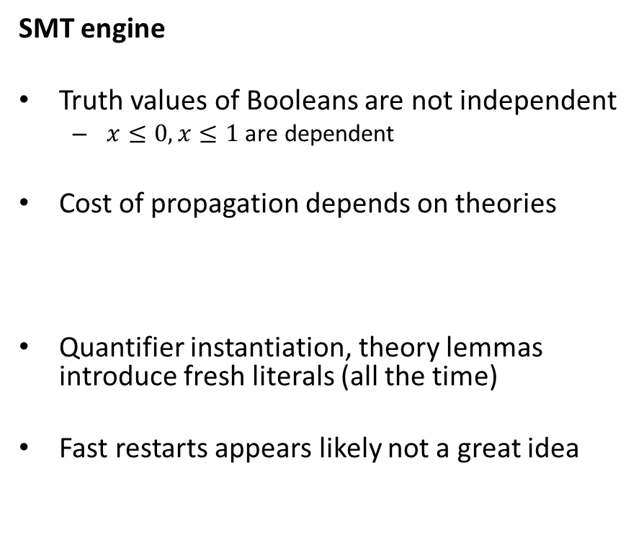
CDCL(T) – SAT vs SMT
SAT engine
Truth assignment is symmetric for Boolean variables
Probing (for failed literals)
L is failed if asserting L & F infers false by unit propagation.
Cost of propagation controlled by clause watch list
Boolean Variables are fixed during search
“Fast restart” introduced to prioritize variables used in conflicts
SMT engine
Truth values of Booleans are not independent
$x≤0, x≤1$ are dependent
Cost of propagation depends on theories
Quantifier instantiation, theory lemmas introduce fresh literals (all the time)
Fast restarts appears likely not a great idea

Slide 27
SPACER, NSLSAT, QSAT

Slide 28
Core Decision Procedures

Slide 29
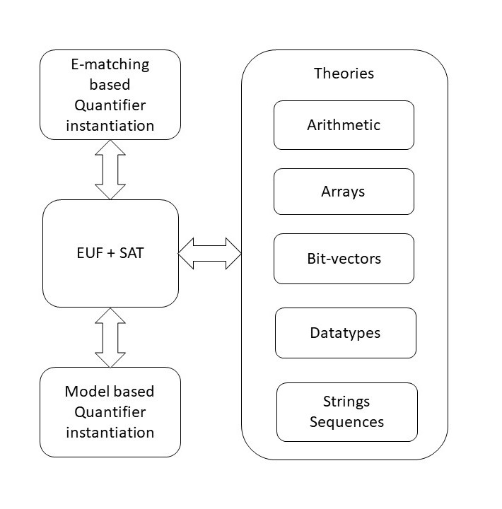
overview

Slide 30
Classification
Arrays
Finite Domains
ADTs
EUF
Arithmetic
Hybrid
str.len, bv2nat
User-Propagator

Slide 31
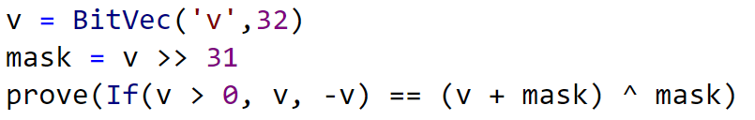
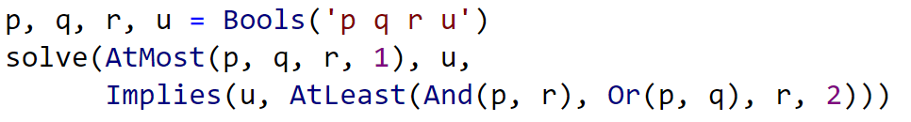
Finite Domain Theories

Slide 32
Finite Domains and CDCL(T)
Compile to SAT
Compile to SAT + E
PolySAT?

Slide 33
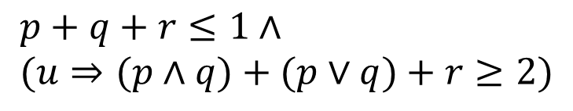
Finite Domains and CDCL(T)
$$p+q+r≤1∧ \\ (u⇒(p∧q)+(p∨q)+r≥2)$$
Compile to CDCL
Compile to CDCL + PB propagation

Slide 34
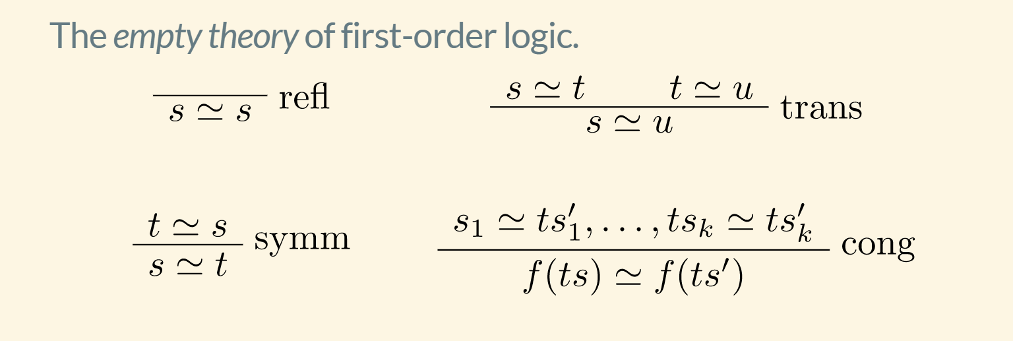
EUF

Slide 35
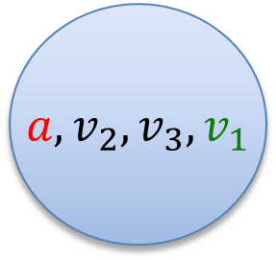
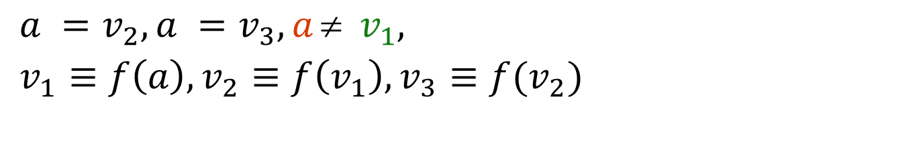
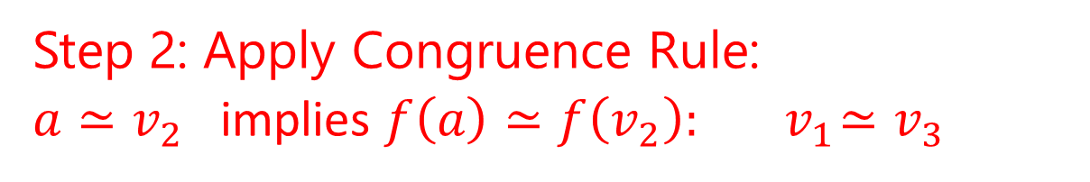
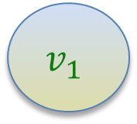
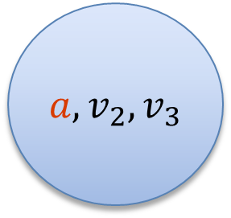
EUF
$$a = f(f(a)), a = f(f(f(a))), a  f(a)$$
Produce Proofs
Incremental Updates
Propagate Literals
$a =v_{2}, a =v_{3}, a  v_{1},$
$v_{1}≡f\left(a\right), v_{2}≡f\left(v_{1}\right), v_{3}≡f(v_{2})$
$a, v_{2}, v_{3}$
$$v_{1}$$
Union Find
Step 1: Equivalence classes from equalities
$a, v_{2}, v_{3}, v_{1}$
Step 2: Apply Congruence Rule:
$a≃v_{2}$ implies $f\left(a\right)≃f\left(v_{2}\right):{ v}_{1}≃v_{3}$
E-graph

Slide 36
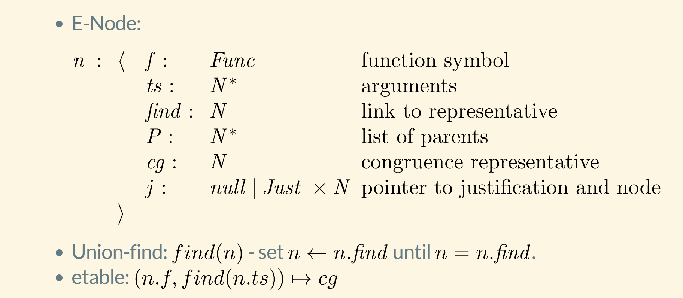
EUF – data-structure

Slide 37
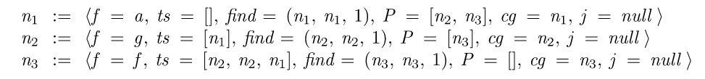
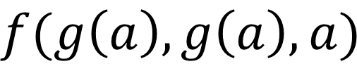
EUF - internalize
$$f(g\left(a\right), g\left(a\right), a)$$
Terms are “hash-consed”
Roots are initialized to self
etable: $[a↦n_{1},g\left(\left[n_{1}\right]\right)↦n_{2}, f\left(\left[n_{2},n_{2},n_{1}\right]\right)↦n_{3}]$

Slide 38
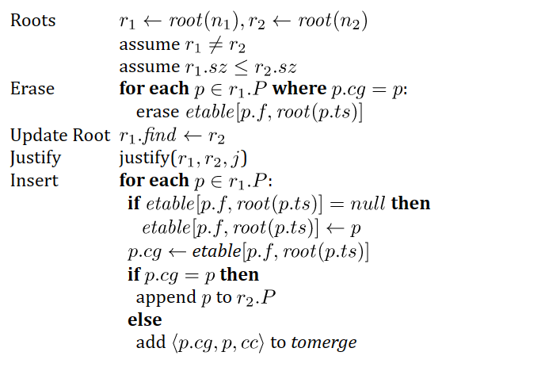
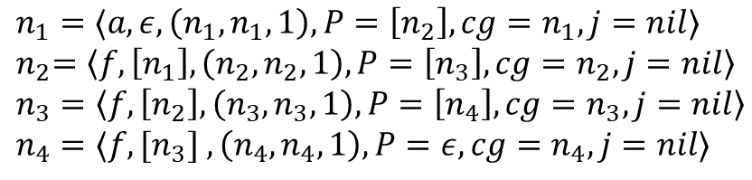

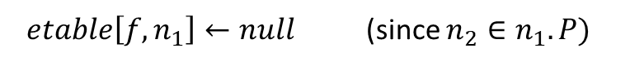
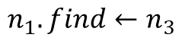
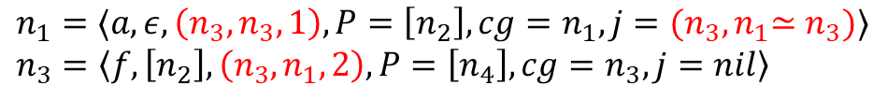
EUF - merge
$n_{1}=⟨a, ε, \left(n_{1},n_{1},1\right), P=\left[n_{2}\right], cg=n_{1},j=nil⟩$
${ n}_{2}=\left\langle f,\left[n_{1}\right], \left(n_{2},n_{2},1\right), P=\left[n_{3}\right], cg=n_{2},j=nil\right\rangle$
$n_{3}=\left\langle f,\left[n_{2}\right], \left(n_{3},n_{3},1\right), P=\left[n_{4}\right], cg=n_{3},j=nil\right\rangle$
$n_{4}=⟨f,[n_{3}] , \left(n_{4},n_{4},1\right), P=ε, cg=n_{4},j=nil⟩$
$${merge(n}_{1},n_{3})$$
$etable\left[f,n_{1}\right]←null$ (since $n_{2}∈n_{1}.P)$
$$n_{1}.find←n_{3}$$
$n_{1}=⟨a, ε, \left(n_{3},n_{3},1\right), P=\left[n_{2}\right], cg=n_{1},j={(n_{3},n}_{1}≃n_{3})⟩$
$n_{3}=\left\langle f,\left[n_{2}\right], \left(n_{3},n_{1},2\right), P=\left[n_{4}\right], cg=n_{3},j=nil\right\rangle$
($n_{2}∈n_{1}.P)$
$n_{2}.cg←etable[f, {root(n}_{1})]=$ $n_{4}$
$add \left\langle n_{2},n_{4}\right\rangle$ to tomerge

Slide 39
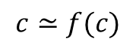
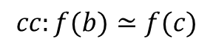
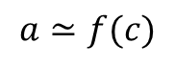
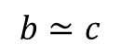
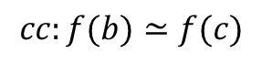
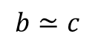
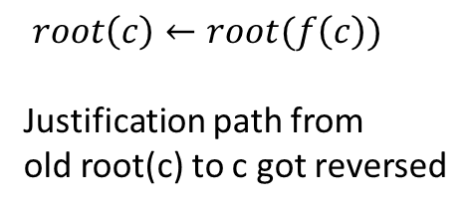
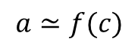
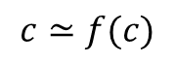
EUF - Justifications
a
b
Union – find link
$$a≃f(c)$$
$$b≃c$$
Justification link
f(b)
f(c)
c
$$cc:f(b)≃f(c)$$
a
After merge
$$c≃f(c)$$
$$a≃f(c)$$
b
$root\left(c\right)←root(f\left(c\right))$
Justification path from
old root(c) to c got reversed
$$b≃c$$
f(b)
f(c)
$$cc:f(b)≃f(c)$$
c
$$c≃f(c)$$

Slide 40

EUF - internals
Nodes from Boolean literals contain fields:
value : { true, false, undef}
boolVar : a number referring to Boolean variable as known by SAT solver
Equality nodes are special: When n1, n2 are merged, the parent n5 is equality, value = false -> conflict
$$a  f(a)$$
$n_{5}=⟨≃, [n_{1},n_{2}], \left(n_{5},n_{5},1\right), P=ε, cg=n_{5},j=nil, value=false, boolVar=27⟩$

Slide 41
EUF – internals: equalities and values
Values: If a node comes from a term that denotes a value (5, 42, 2/3, cons(1,nil)), it is always a root
When two roots with terms based on different values are merged -> conflict
Who reasons about equalities of Booleans? EUF vs. CDCL
E-nodes based on Bool do by default not merge with other nodes.
Default is overridden if E-node occurs under a non-connective.
E-graph propagates equalities to theories and Booleans to SAT
$n_{5}=\left\langle ≃, \left[n_{1},n_{2}\right], \left(n_{5},n_{5},1\right), P=ε, cg=n_{5},j=nil, value=undef, boolVar=27\right\rangle$
$n_{1}.find←n_{2}$ -> value is set to true and assignment to boolVar 27 is propagated to CDCL core

Slide 42
Arithmetic
SAT/SMT Backtracking
Search
Propagation
+ Conflicts
Assert bounds on integer/real variables
Solve for Reals Use Simplex to find solutions to constraints + bounds
Bounds propagation Infer equalities and bounds from existing bounds
Solve for Integers
Cube
GCD test
Branch and Bound
Hermite Normalize
Gomory Cuts
Solve for multiplications
Bounds propagation
Horner expansion
Gröbner solving
Incremental linearization
NL-SAT
SAT

Slide 43
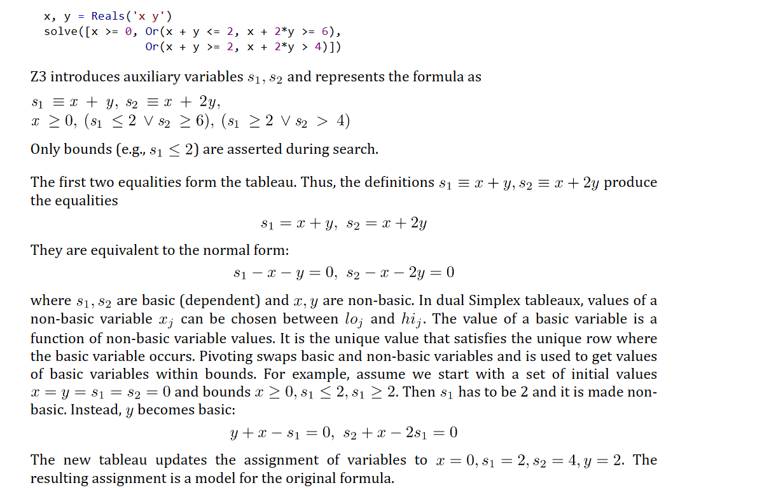
Arithmetic - LP
Placeholder

Slide 44
Arithmetic - LP

Slide 45
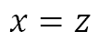





Propagating Equalities
SAT/SMT Backtracking
Search
$$x=z$$
$$x+1=y$$
Assert bounds on integer/real variables
$$y −1=z$$
Complete method [Bromberger & Weidenbach]:
1. Turn $≥$ into $>$ on asserted bounds.
2. If new inequalities are infeasible, then $≥$ can be strengthened to $=$ in minimal unsat core.
Bounds propagation Infer equalities and bounds from existing bounds
$$\underline{x+1=y y −1=z}$$
$$x=z$$

Slide 46



Propagating Equalities
Equality inferences require addition/subtraction operations
Asserted inequalities
$x+u≤z z −1≤y y≤x 1≤u≤1$
$$\underline{x+1=y y −1=z}$$
$$x=z$$
How the solver sees the constraints
$x+u+s_{1}=z z −1+s_{2}=y y+s_{3}=x 1≤u≤1 0≤s_{1} 0≤s_{2} 0≤s_{3}$
After pivoting
$$x=z−u −s_{1} y=z −1+s_{2} s_{3}={−s}_{2}− {u+1− s}_{1} 1≤u≤1 0≤s_{1} 0≤s_{2} 0≤s_{3}$$
After propagating bounds on $s_{1}, s_{2},s_{3}$
$$x=z−u −s_{1} y=z −1+s_{2} s_{3}={−s}_{2}− {u+1− s}_{1} 1≤u≤1 0≤s_{1}≤0 0≤s_{2}≤0 0≤s_{3}≤0$$
Subtract first two equalities to infer
$$x=y$$
Subtle complexity: Every row can have many fixed variables. Adding values of constant bounds requires significant runtime.

Slide 47




Propagating Equalities - efficiently
$$\underline{x=z−u −s_{1} y=z −1+s_{2} 1≤u≤1 0≤s_{1}≤0 0≤s_{2}≤0 0≤s_{3}≤0}$$
$$x=y$$
Instead of adding up rows to prove implied equality
Use fact all variables have values assigned by Simplex solver
Then two variables are equal if
They are connected through offset equalities
They have the same value
offset equality
$$x=y+{\underset{{b_{1}≤z}_{1}≤b_{1}, { b}_{2}≤z_{2}≤b_{2},}{\underbrace{{a_{1}z}_{1}+a_{2}z_{2}+…}}}_{}$$
Example: If solver assigns $x=3$ then $z=4, y=3$
$x, y$ are connected (over $z−1$).
$x, y$ have the same value (3)

Slide 48
Arithmetic – Integers
Cube
GCD
(picture of a polyhedron)
(twist for difference/octagon)
(example GCD)
Branch and bound
Cut
(a note about cut strength)
(a note about SAT problems)

Slide 49
Arithmetic – Integers
In scope
Bounds propagation to CDCL
Equality propagation to T
Modeling at level of SMT
Out of scope
Finite domains
Weak cuts
Incomplete for mixed-Integer
Modular arithmetic and LP

Slide 50



Arithmetic – Non-linear
Non-linear bounds
Gröbner
Factoring and equality propagation
$$xy=0∧xyz+u−v=0⇒u=v$$
Solving (based on variable ordering)
$$x+p=0∧x^{2}q+r=0⇒p^{2}q+r=0$$
Result of GB used for bounds propagation
(Interval propagation)
(representation strength)
Polynomials as
Multi-terminal ZDDs
Incremental Linearization
NLSAT
(tangent and other lemmas)
(how it is staged?)

Slide 51
Arithmetic – Non-linear
In scope
Bounds and Equality propagation
Polynomials over reals (low degree)
Out of scope
Polynomials over integers
Exponentiation
Trigonometric functions
Indefinite operations
summations/products/integrals

Slide 52
Data-types, Arrays

Slide 53


Custom Theories

Slide 54
Solver Internals

Slide 55


Terms and Formulas
de Bruijn index
Terms are hash-consed
let t = App(f,args) let t’ = termTable[t] mkApp(f, args) = if t’ = nil then termTable[t]$←t$; t else t’

Slide 56


Assertion Internals
(assert (! p :named q))
SMT2 file
assert_and_track(p, q);
API
$$⟨φ=p, π=assume\left(p\right), δ=q⟩$$
Pre-processing simplification
Tactics
Core uses
dependencies
Solver
Transformed Assertions
Proof uses justifications

Slide 57



From Assertions to Solver State
$$x≥0 ∨ (p∧q\left(x\right))$$
Clauses
$\left(1 2\right) \left(1 3\right)$
$1↦x≥0, 2↦p, 3↦q(x)$
$n_{23}:⟨f=x,args=ε,$ $P=\left[n_{27}\right],$ $th=\left[\left(arith, 4\right)\right]⟩$
bool_var2node
E-nodes
z3 search.smt2 /tr:euf tactic.default_tactic=smt sat.smt=true

Slide 58






Core $↔$ Solver interface
CDCL
EUF Core
Solver
$n_{23}:⟨f=x,args=ε,$ $P=\left[n_{27}\right],$ $th=\left[\left(arith, 4\right)\right]⟩$
$n_{25}:⟨≥, args=ε,$ $$th=[\left(arith,5\right)]$$
$$assigned\left(ℓ@1\right)$$
$$propagate\left(x≥0@5, Explain\right)$$
Dispatch Theory Solver
$$propagate\left(ℓ, Explain\right)$$
$$propagate\left(n≃n′, Explain\right)$$
Does not participate in congruence closure
Theory variable

Slide 59




Model-based Theory Combination
$$x=f\left(z\right), f\left(x\right)≃f\left(y\right), 0≤x≤1, 0≤y≤1, z=y −1$$
$x= ⋆_{1}y= ⋆_{2}z= ⋆_{3}$ $x=1, y=1, z=0$
$f\left(⋆_{1}\right)= ⋆_{1}f\left(⋆_{2}\right)= ⋆_{2}f\left(⋆_{3}\right)=⋆_{1}$
Create fresh literal $x≃y$
Case split on $x≃y←⊤$
Conflict, backtrack $x≠y$
$$x=f\left(z\right), f\left(x\right)≃f\left(y\right), 0≤x≤1, 0≤y≤1, z=y −1,x≠y$$
Create fresh literal $x≃y$
Case split on $x≃y←⊤$
$x= ⋆_{1}y= ⋆_{2}z= ⋆_{1}$ $x=0 y=1, z=0$
$f\left(⋆_{1}\right)= ⋆_{1}f\left(⋆_{2}\right)= ⋆_{2}$
$$x≃z$$

Slide 60

Relevancy Filtering
Purpose: expose only subset of literal assignments to T solvers
Reason: Delays introduction of terms for T-and quantifier instantiation
Idea: Simulate tableau reasoning on top of CDCL
$$(\left(a∧b\right)∨c)$$
$\left(\left(a∧b\right)∨c\right) (¬\left(a∧b\right)∨a)$ $\left(¬\left(a∧b\right)∨b\right)$ $\left(\left(a∧b\right)∨¬a∨¬b\right)$
Root clause
Definition clauses
Scenario 1: c is assigned to T, root clause is satisfied. Atoms $\left(a∧b\right), a, b$ are never set relevant
Scenario 2: c is assigned to F, $\left(a∧b\right)$ is assigned T. Atoms $a, b$ are marked relevant (and propagated to T)

Slide 61


Ackermann reductions

Slide 62

Iterative Deepening
Assume ((_ is nil) list1) ((_ is nil) list2)
Unsat core: ((_ is nil) list1)
Assume ((_ is nil) (tail list1)) ((_ is nil) list2)
Unsat core: ((_ is nil) list2)
Assume ((_ is nil) (tail list1)) ((_ is nil) (tail list2))
Unsat core: ((_ is nil) (tail list1))
Assume ((_ is nil) (tail (tail list1))) ((_ is nil) (tail list2))
SAT

Slide 63
Interfacing with Z3
A Quiz and some Answers

Slide 64
Efficiency
Scale
Technology Landscape
Propositional
Satisfiability Solving
SAT
Breakthroughs in 2000s
Cheap local Inferences
Garbage collect useless clauses
Hardware Design
Automation
Breakthroughs late 2000s
SAT + global inferences +
global propagators
Mixed Integer
Programming
MIP
Breakthroughs in 1960s
Harnessed since 1990s
LP: global Inferences
IP: Cuts, Branch and Bound
Satisfiability Modulo Theories
Operations
Research
CP-SAT
SMT
Z3
Constraint
Programming
Software Development +…
CP
Breakthroughs since 1990s
Powerful domain-tailored
global propagators
Expressive Power

Slide 65
Satisfiability Modulo Theories (SMT)
Is formula ϕ satisfiable modulo theory T ?
SMT solvers have specialized algorithms for T

Slide 66
Formulating Formulas for Z3
Capturing Finite domains as propositional theories
SAT
BV = SAT or SAT + equality propagation
PB = SAT + cardinality + weighted Boolean inequalities
Symmetries
Programming With Quantifiers

Slide 67
Controlling Search
SAT engine control
Variable phases
Sat.threads, parallel.enable
Lookahead Solving
Ackermann reduction
Arithmetic and finite domains

Slide 68
Retrieving Information
Model, Core, Proof
Clausal Proof Logs, Trace
API Log, SMT log, Lemma log

Slide 69
Tactics

Slide 70
Example tactic
What is a tactic
Properties of tactics
Use case of Alive2

Slide 71
Online reference to tactics
Classification of tactics
Incremental tactics

Slide 72
Models

Slide 73
Model Formats

Slide 74
Extracting Models

Slide 75
Certificates

Slide 76
Certificate Formats

Slide 77
Using Certificates

Slide 78
Quantifiers

Slide 79
E-matching

Slide 80
MBQI

Slide 81
MBP

Slide 82
SAT + Theory Solvers A basis for SMT

Slide 83
A Universe of Theories and Solvers

Slide 84
A universe of theories
Boolean | finite domains
Base | arithmetic and uninterpreted functions
Reducible | reduce to base theories
Hybrid | non-disjoint combinations
External | propagation rules

Slide 85


A universe of theories
Base | arithmetic and uninterpreted functions (EUF)

Slide 86


A universe of theories
Reducible | reduce to base theories
Compile into EUF
UNSAT

Slide 87


A universe of theories
Reducible | reduce to base theories
Convert EUF solution to
solution over arrays
Compile into EUF

Slide 88


A universe of theories
Hybrid | non-disjoint combinations
$$\frac{s=\text{"}\text{abcd}\text{" }u=\text{"}\text{def}\text{"} |t|=\text{7}}{t="\text{abcddef}"}$$

Slide 89


A universe of theories
External | propagation rules
When encodings into existing theories is too expensive
$$1000≥\sum_{0≤i<j≤500}{x_{i}+x_{j}=42∧\left(x_{i}>30∨x_{j}>30\right)}$$
As code:
Introduces one callback + conflicts on demand
As constraints:
Introduces 100Ks
atomic formulas

Slide 90
The usual z3 intro slides

Slide 91




Logic: The Calculus of Computation
Invariants
Differential, Integral Calculus
Logic
Dynamics, Conduction,..
Matlab, Mathemetica, Simulink
Computation
Claim: Practically all modern program analysis tools involve solving logical formulas

Slide 92















for Software +…
Azure Network
Verification
Verifying C
Compiler
Quantum
Compilation
Biological
Computations
Verified Crypto
Libraries & Protocols
Dynamics
AX
SVACE
Static Analysis Engines
Artificial
Life
Security Risk Detection
Smart Contract
Verification
ALIVE2
Translation Validation
for LLVM & Visual C++
Axiomatic
Economics
Assembly Line
Optimization

